Slide 2
Python Break and Continue
In Python, break and continue statements can alter the flow of a normal loop. Loops iterate over a block of code until test expression is false, but sometimes we wish to terminate the current iteration or even the whole loop without checking test expression. The break and continue statements are used in these cases.
Break Statement
The break statement terminates the loop containing it. Control of the program flows to the statement immediately after the body of the loop. If it is inside a nested loop (loop inside another loop), break will terminate the innermost loop.

Slide 3
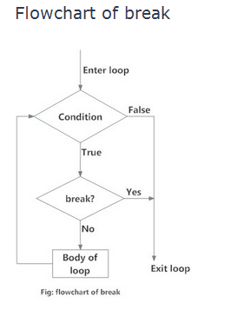
Break

Slide 4
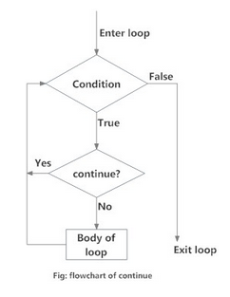
continue statement
The continue statement is used to skip the rest of the code inside a loop for the current iteration only. Loop does not terminate but continues on with the next iteration.

Slide 5
Python Numbers
Number data types store numeric values. They are immutable data types, means that changing the value of a number data type results in a newly allocated object.
Number objects are created when you assign a value to them. For example −
var1 = 1
var2 = 10

Slide 6
Python supports four different numerical types −
int (signed integers): They are often called just integers or int, are positive or negative whole numbers with no decimal point.
long (long integers ): Also called longs, they are integers of unlimited size, written like integers and followed by an uppercase or lowercase L.
float (floating point real values) : Also called floats, they represent real numbers and are written with a decimal point dividing the integer and fractional parts
complex (complex numbers) : are of the form a + bJ, where a and b are floats and J (or j) represents the square root of -1 (which is an imaginary number). The real part of the number is a, and the imaginary part is b. Complex numbers are not used much in Python programming.

Slide 7
Number Type Conversion
Type int(x) to convert x to a plain integer.
Type long(x) to convert x to a long integer.
Type float(x) to convert x to a floating-point number.
Type complex(x) to convert x to a complex number with real part x and imaginary part zero.

Slide 8
Mathematical Functions
abs(x)
Ceil(x)
cmp (x, y)
exp (x)
Floor(x)
Log(x)
pow (x,y)
sqrt(x,y )
Max (x1,x2….xn)
Min (x1,x2…xn)

Slide 9
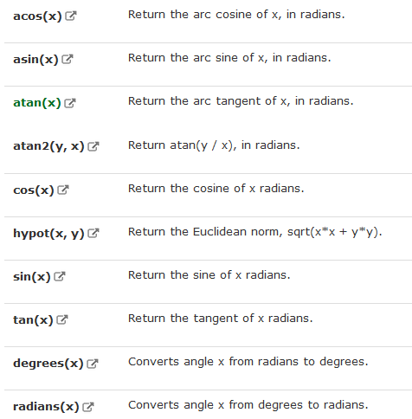
Trigonometric Functions

